Slide 1


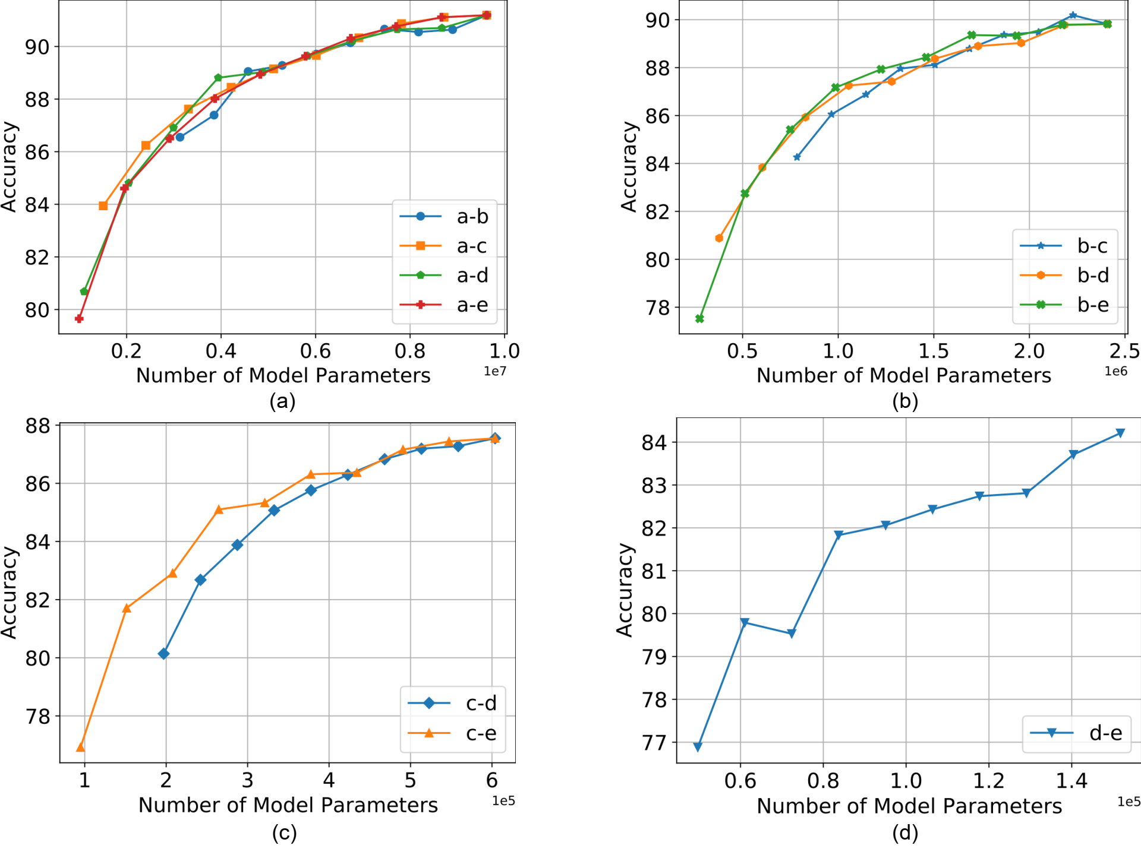
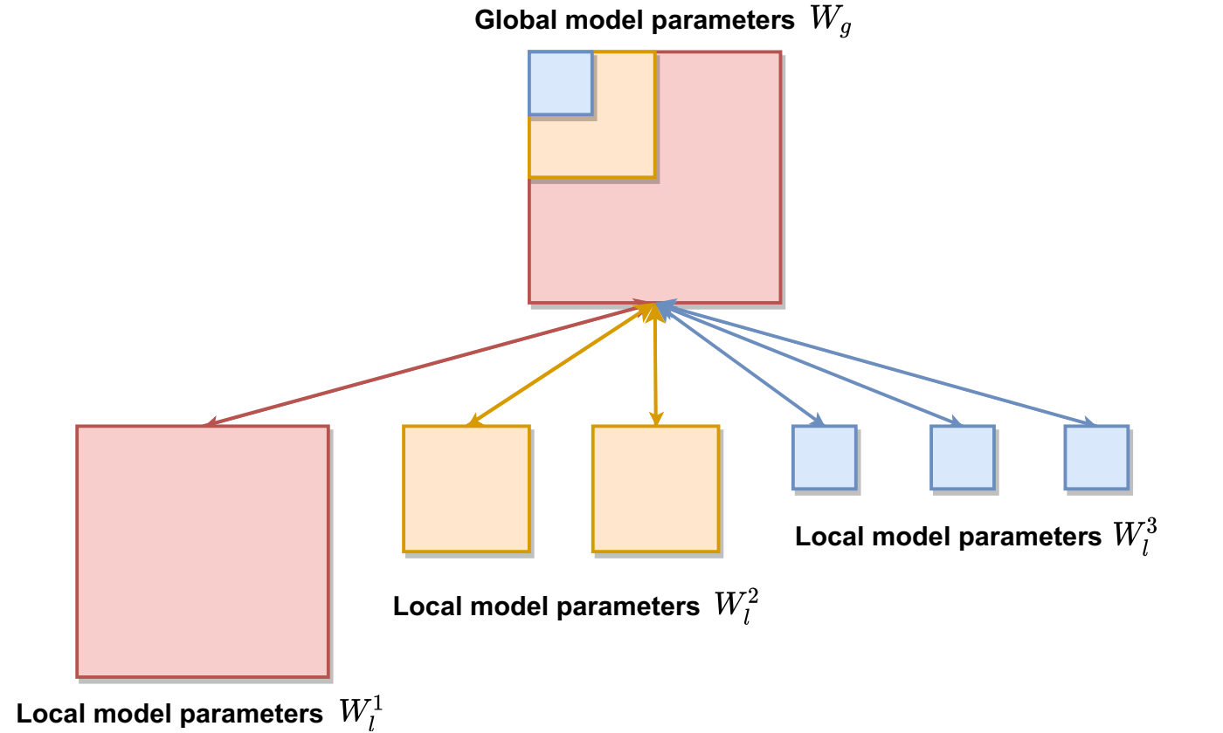
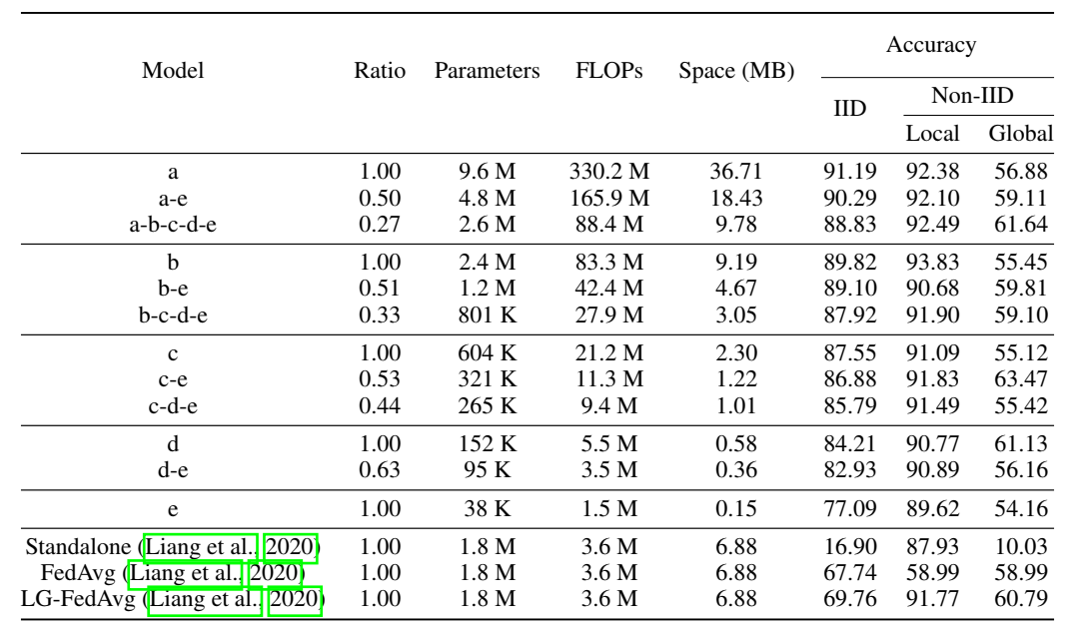
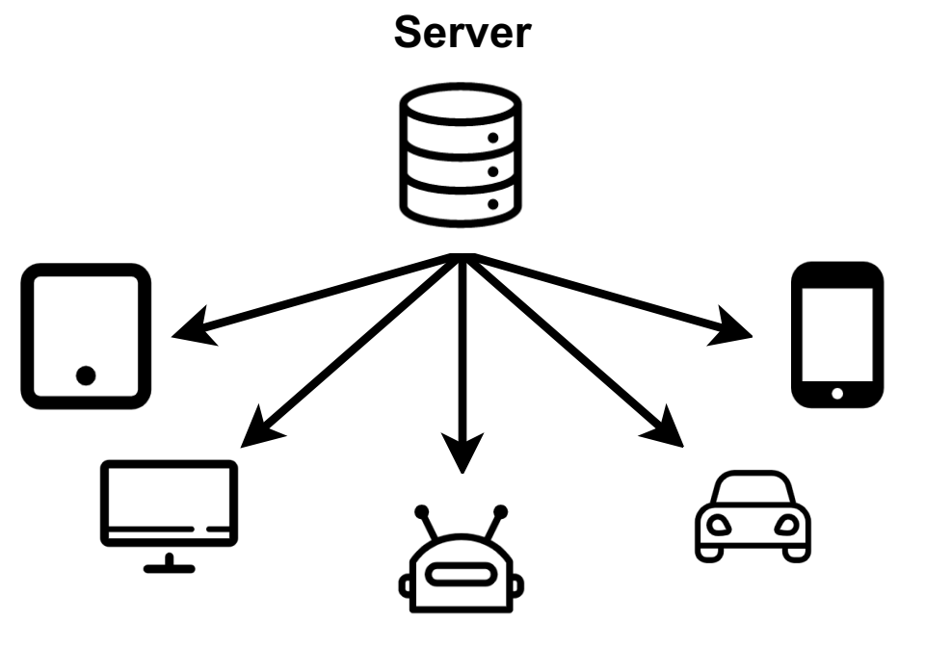



HeteroFL: Computation and Communication Efficient Federated Learning for Heterogeneous Clients
Enmao Diao¹ Jie Ding² Vahid Tarokh¹
¹Duke University ²University of Minnesota-Twin Cities
Overview
Heterogeneous Federated Learning
Experiments
In this work, we propose a new federated learning framework named HeteroFL to address heterogeneous clients equipped with very different computation and communication capabilities. Our solution can enable the training of heterogeneous local models with varying computation complexities and still produce a single global inference model.
We identify the possibility of model heterogeneity and propose an easy-to-implement framework HeteroFL that can train heterogeneous local models and aggregate them stably and effectively into a single global inference model.
Our proposed solution addresses various heterogeneous settings where different proportions of clients have distinct capabilities. Our results demonstrate that even when the model heterogeneity changes dynamically, the learning result from our framework is still stable and effective.
We introduce several strategies including static Batch Normalization (sBN), scaler, and Masked Cross-Entropy Loss for improving HeteroFL against the balanced non-IID statistical heterogeneity.
Each parameter will be averaged from those clients whose allocated parameter matrix contains that parameter.
A model of an intermediate complexity will have parameters fully averaged with all the other larger models but partially with smaller models.
Small local models can benefit more from global aggregation by performing less global aggregation for part of larger local model parameters.
Motivation
Figure 3. Interpolation experimental results for CIFAR10 (IID) dataset between global model complexity ((a) a, (b) b, (c) c, (d) d) and various smaller model complexities.
Local models must share the same architecture as the global model in federated learning?
Figure 2. Global model parameters are distributed to 6 local clients with 3 computation complexity levels.
Static Batch Normalization (sBN) does not track running estimates and simply normalize batch data. After the training process finishes, the server sequentially query local clients and cumulatively update global BN statistics.
Scaler scales representations during the training phase and the global model can be directly used for inference without scaling.
Masked Cross-Entropy Loss replaces the last layer outputs that are not associated with local labels with zero significantly improve local performance and moderately global performance of balanced non-IID data partition task.
Figure 1. The computation and communication capabilities of each local client may vary significantly and even dynamically.
Paper
Code
Table 1. Results of combination of various computation complexity levels for CIFAR10 dataset.
References
McMahan, Brendan, et al. "Communication-efficient learning of deep networks from decentralized data." Artificial Intelligence and Statistics. PMLR, 2017.
Liang, Paul Pu, et al. "Think locally, act globally: Federated learning with local and global representations." arXiv preprint arXiv:2001.01523 (2020).

